Slide 1
Lab 8: Multivariate models
May 19, 2016

Slide 2
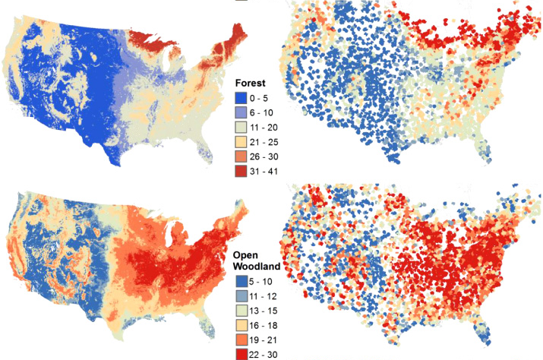
Species richness of North American birds from Breeding Bird Survey
Image: Goetz et al. 2014 Environ. Res. Lett.

Slide 3
Community distribution models
Why an interest in distributions?
Suggestive of environmental and biological drivers
Motivate subsequent models and research
Distribution maps are intuitive for many users
Framework for local and traditional knowledge
Distribution models are a playground
Explore climate, invasions, habitat restoration, …
Notes:
Explain why I want to do this! (motivates theory of environmental or biological drivers for distributions)

Slide 4
Community distribution models
Spatial ordination is useful for …
Quantifying shared information among species
Identifying species with similar range
Correlating species range with measured variables
Notes:
Predicting rare/undersampled species, bycatch etc.

Slide 5
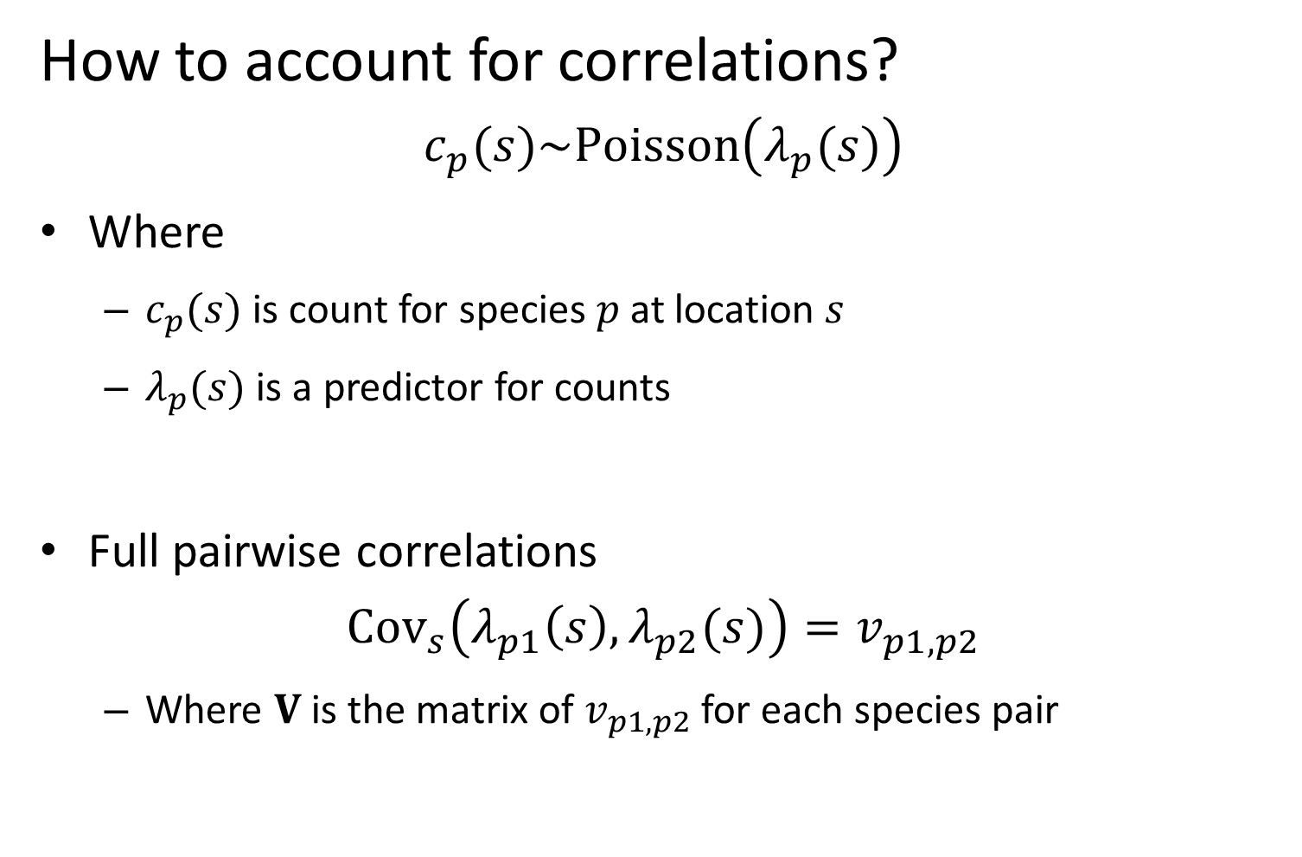
Community distribution models
How to account for correlations?
$$c_{p}(s)\sim Poisson\left(λ_{p}(s)\right)$$
Where
$c_{p}(s)$ is count for species $p$ at location $s$
$λ_{p}(s)$ is a predictor for counts
Full pairwise correlations
$${Cov}_{s}\left(λ_{p1}\left(s\right),λ_{p2}(s)\right)=v_{p1,p2}$$
Where $V$ is the matrix of $v_{p1,p2}$ for each species pair
Notes:
Predicting rare/undersampled species, bycatch etc.

Slide 6
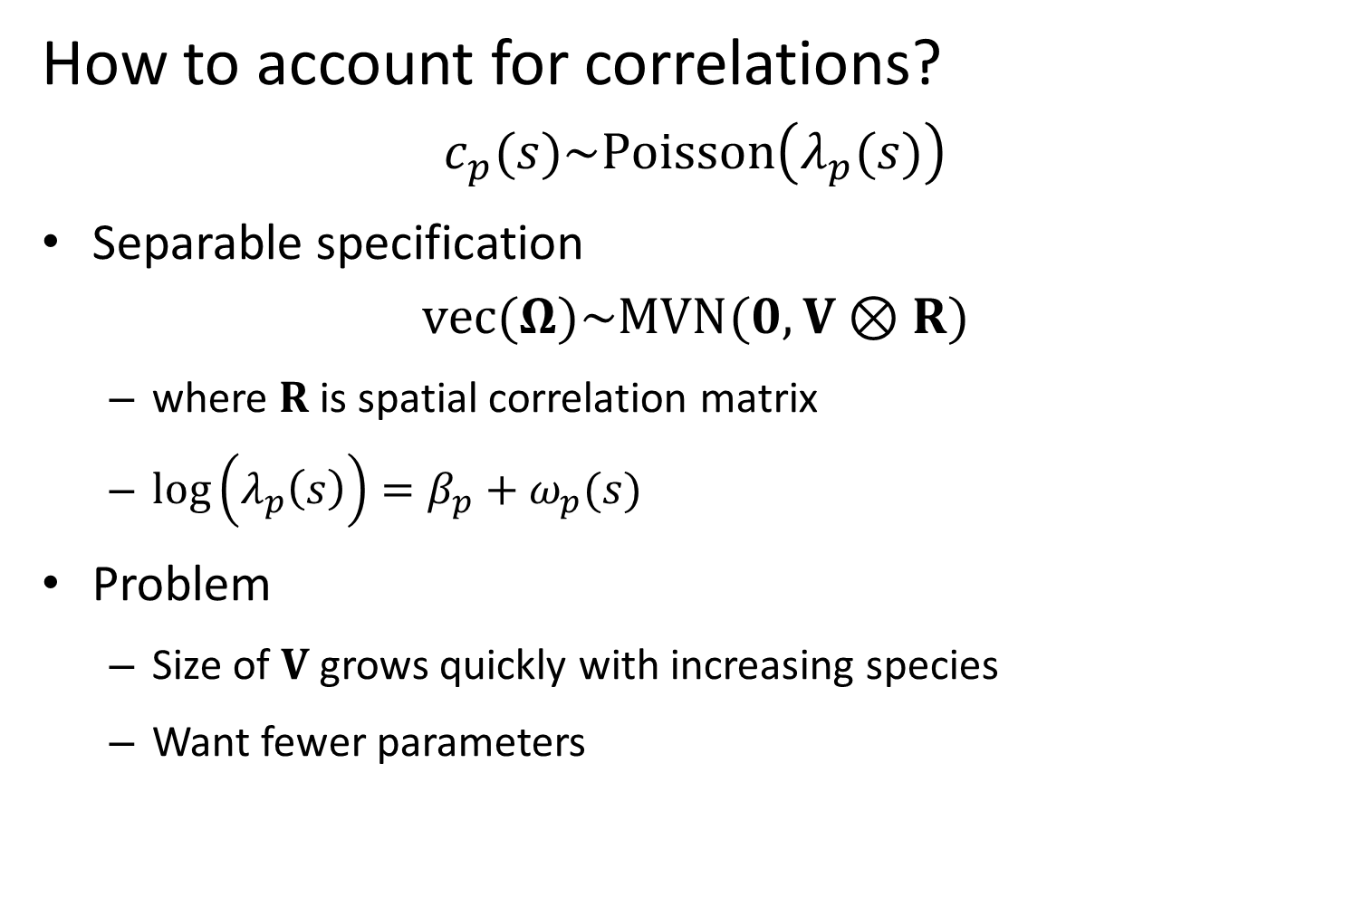
Community distribution models
How to account for correlations?
$$c_{p}(s)\sim Poisson\left(λ_{p}(s)\right)$$
Separable specification
$$vec(Ω)\sim MVN(0,V⊗R)$$
where $R$ is spatial correlation matrix
$\log\left(λ_{p}\left(s\right)\right)=β_{p}+ω_{p}(s)$
Problem
Size of $V$ grows quickly with increasing species
Want fewer parameters
Notes:
Predicting rare/undersampled species, bycatch etc.

Slide 7
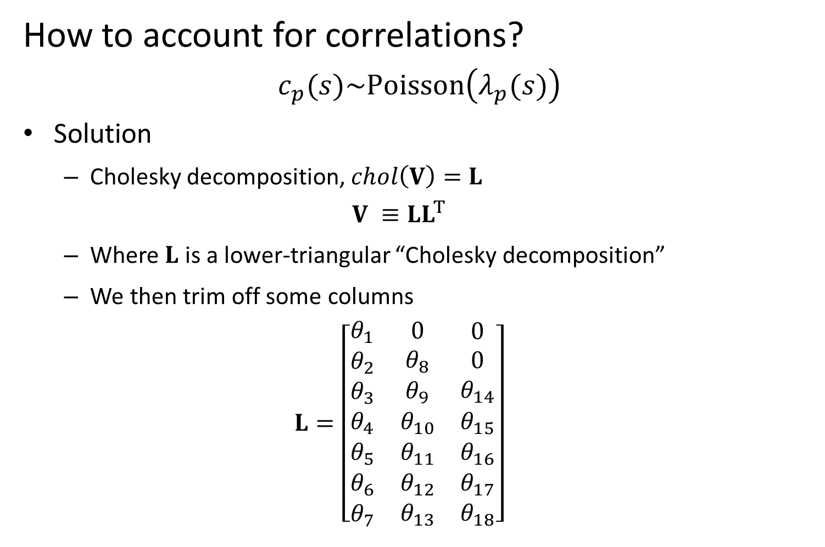
Community distribution models
How to account for correlations?
$$c_{p}(s)\sim Poisson\left(λ_{p}(s)\right)$$
Solution
Cholesky decomposition, $chol\left(V\right)=L$
$$V ≡LL^{T}$$
Where $L$ is a lower-triangular “Cholesky decomposition”
We then trim off some columns
$$L=\left[\begin{matrix}\begin{matrix}θ_{1} \\ θ_{2} \\ θ_{3}\end{matrix} & \begin{matrix}0 \\ θ_{8} \\ θ_{9}\end{matrix} & \begin{matrix}0 \\ 0 \\ θ_{14}\end{matrix} \\ θ_{4} & θ_{10} & θ_{15} \\ \begin{matrix}θ_{5} \\ θ_{6} \\ θ_{7}\end{matrix} & \begin{matrix}θ_{11} \\ θ_{12} \\ θ_{13}\end{matrix} & \begin{matrix}θ_{16} \\ θ_{17} \\ θ_{18}\end{matrix}\end{matrix}\right]$$
Notes:
Predicting rare/undersampled species, bycatch etc.

Slide 8
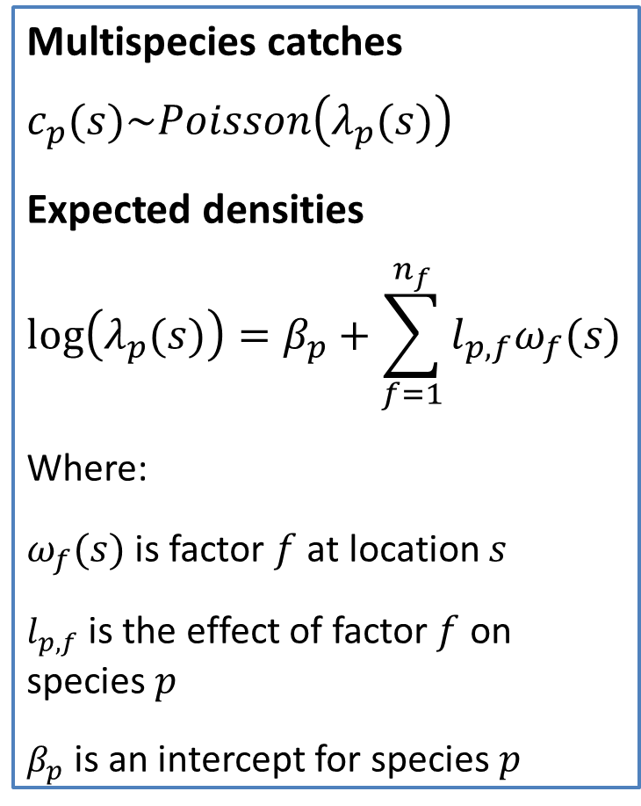
Community distribution models
Spatial factor analysis
Estimates “latent” maps for co-occurring species
Separates process and measurement error
Derived estimates of co-occurrence
Multispecies catches
$$c_{p}(s)\sim Poisson\left(λ_{p}(s)\right)$$
Expected densities
$$log⁡\left(λ_{p}(s)\right)=β_{p}+\sum_{f=1}^{n_{f}}{l_{p,f}ω_{f}(s)}$$
Where:
$ω_{f}(s)$ is factor $f$ at location $s$
$l_{p,f}$ is the effect of factor $f$ on species $p$
$β_{p}$ is an intercept for species $p$
Notes:
Animate in the math

Slide 9
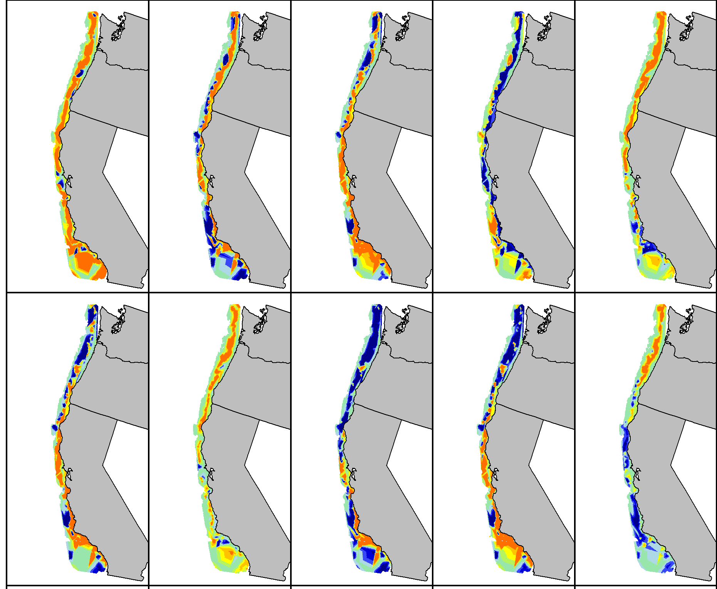
Predicted species distributions: High density / Medium density / Low density
Notes:
Explain colors (red: high);
Fix no-name panel!
Circle darkblotched and aurora (actually bring them forward in new slide)

Slide 10
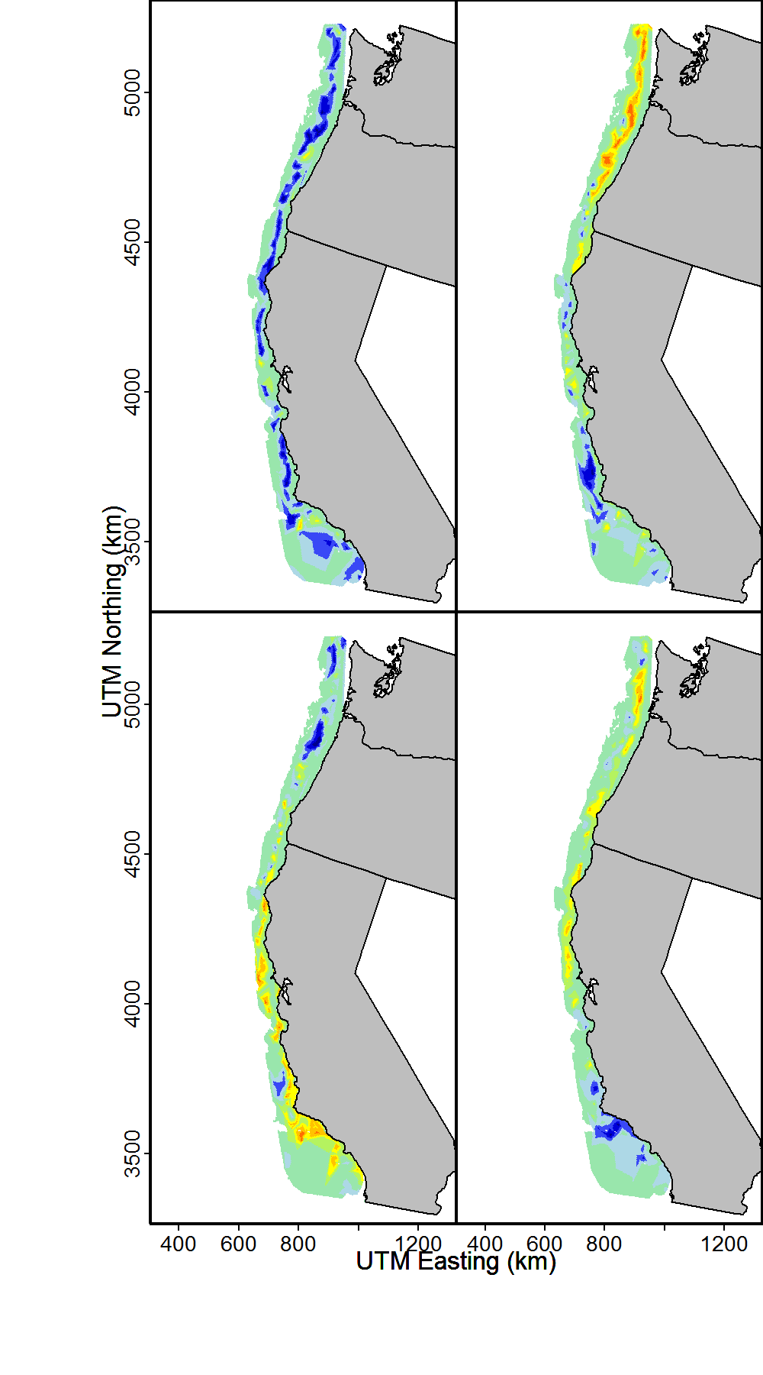
Community distribution models
Estimating latent factors
Estimated spatial factors: High density / Medium density / Low density
Notes:
Lots of shared information;
Talk about measured covariates; biogeographic breaks; searching for better descriptors

Slide 11
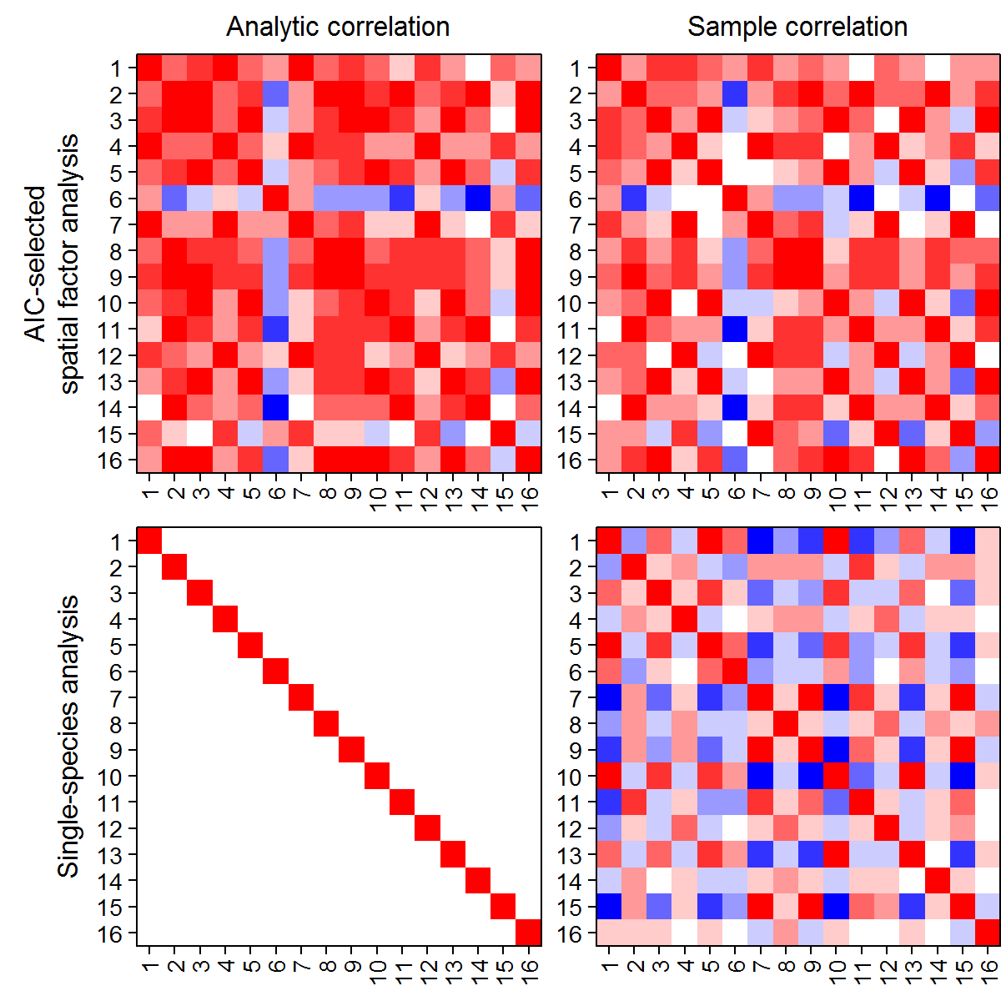
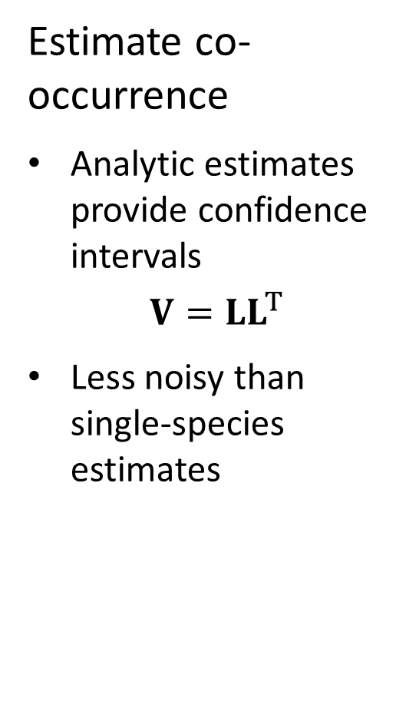
Community distribution models
Estimate co-occurrence
Analytic estimates provide confidence intervals
$$V=LL^{T}$$
Less noisy than single-species estimates
Correlation: 1 0 -1
Notes:
Animate these in; (explain colors immediately – ADD COLORS TO TEXT)
Consider dropping analytic column

Slide 12
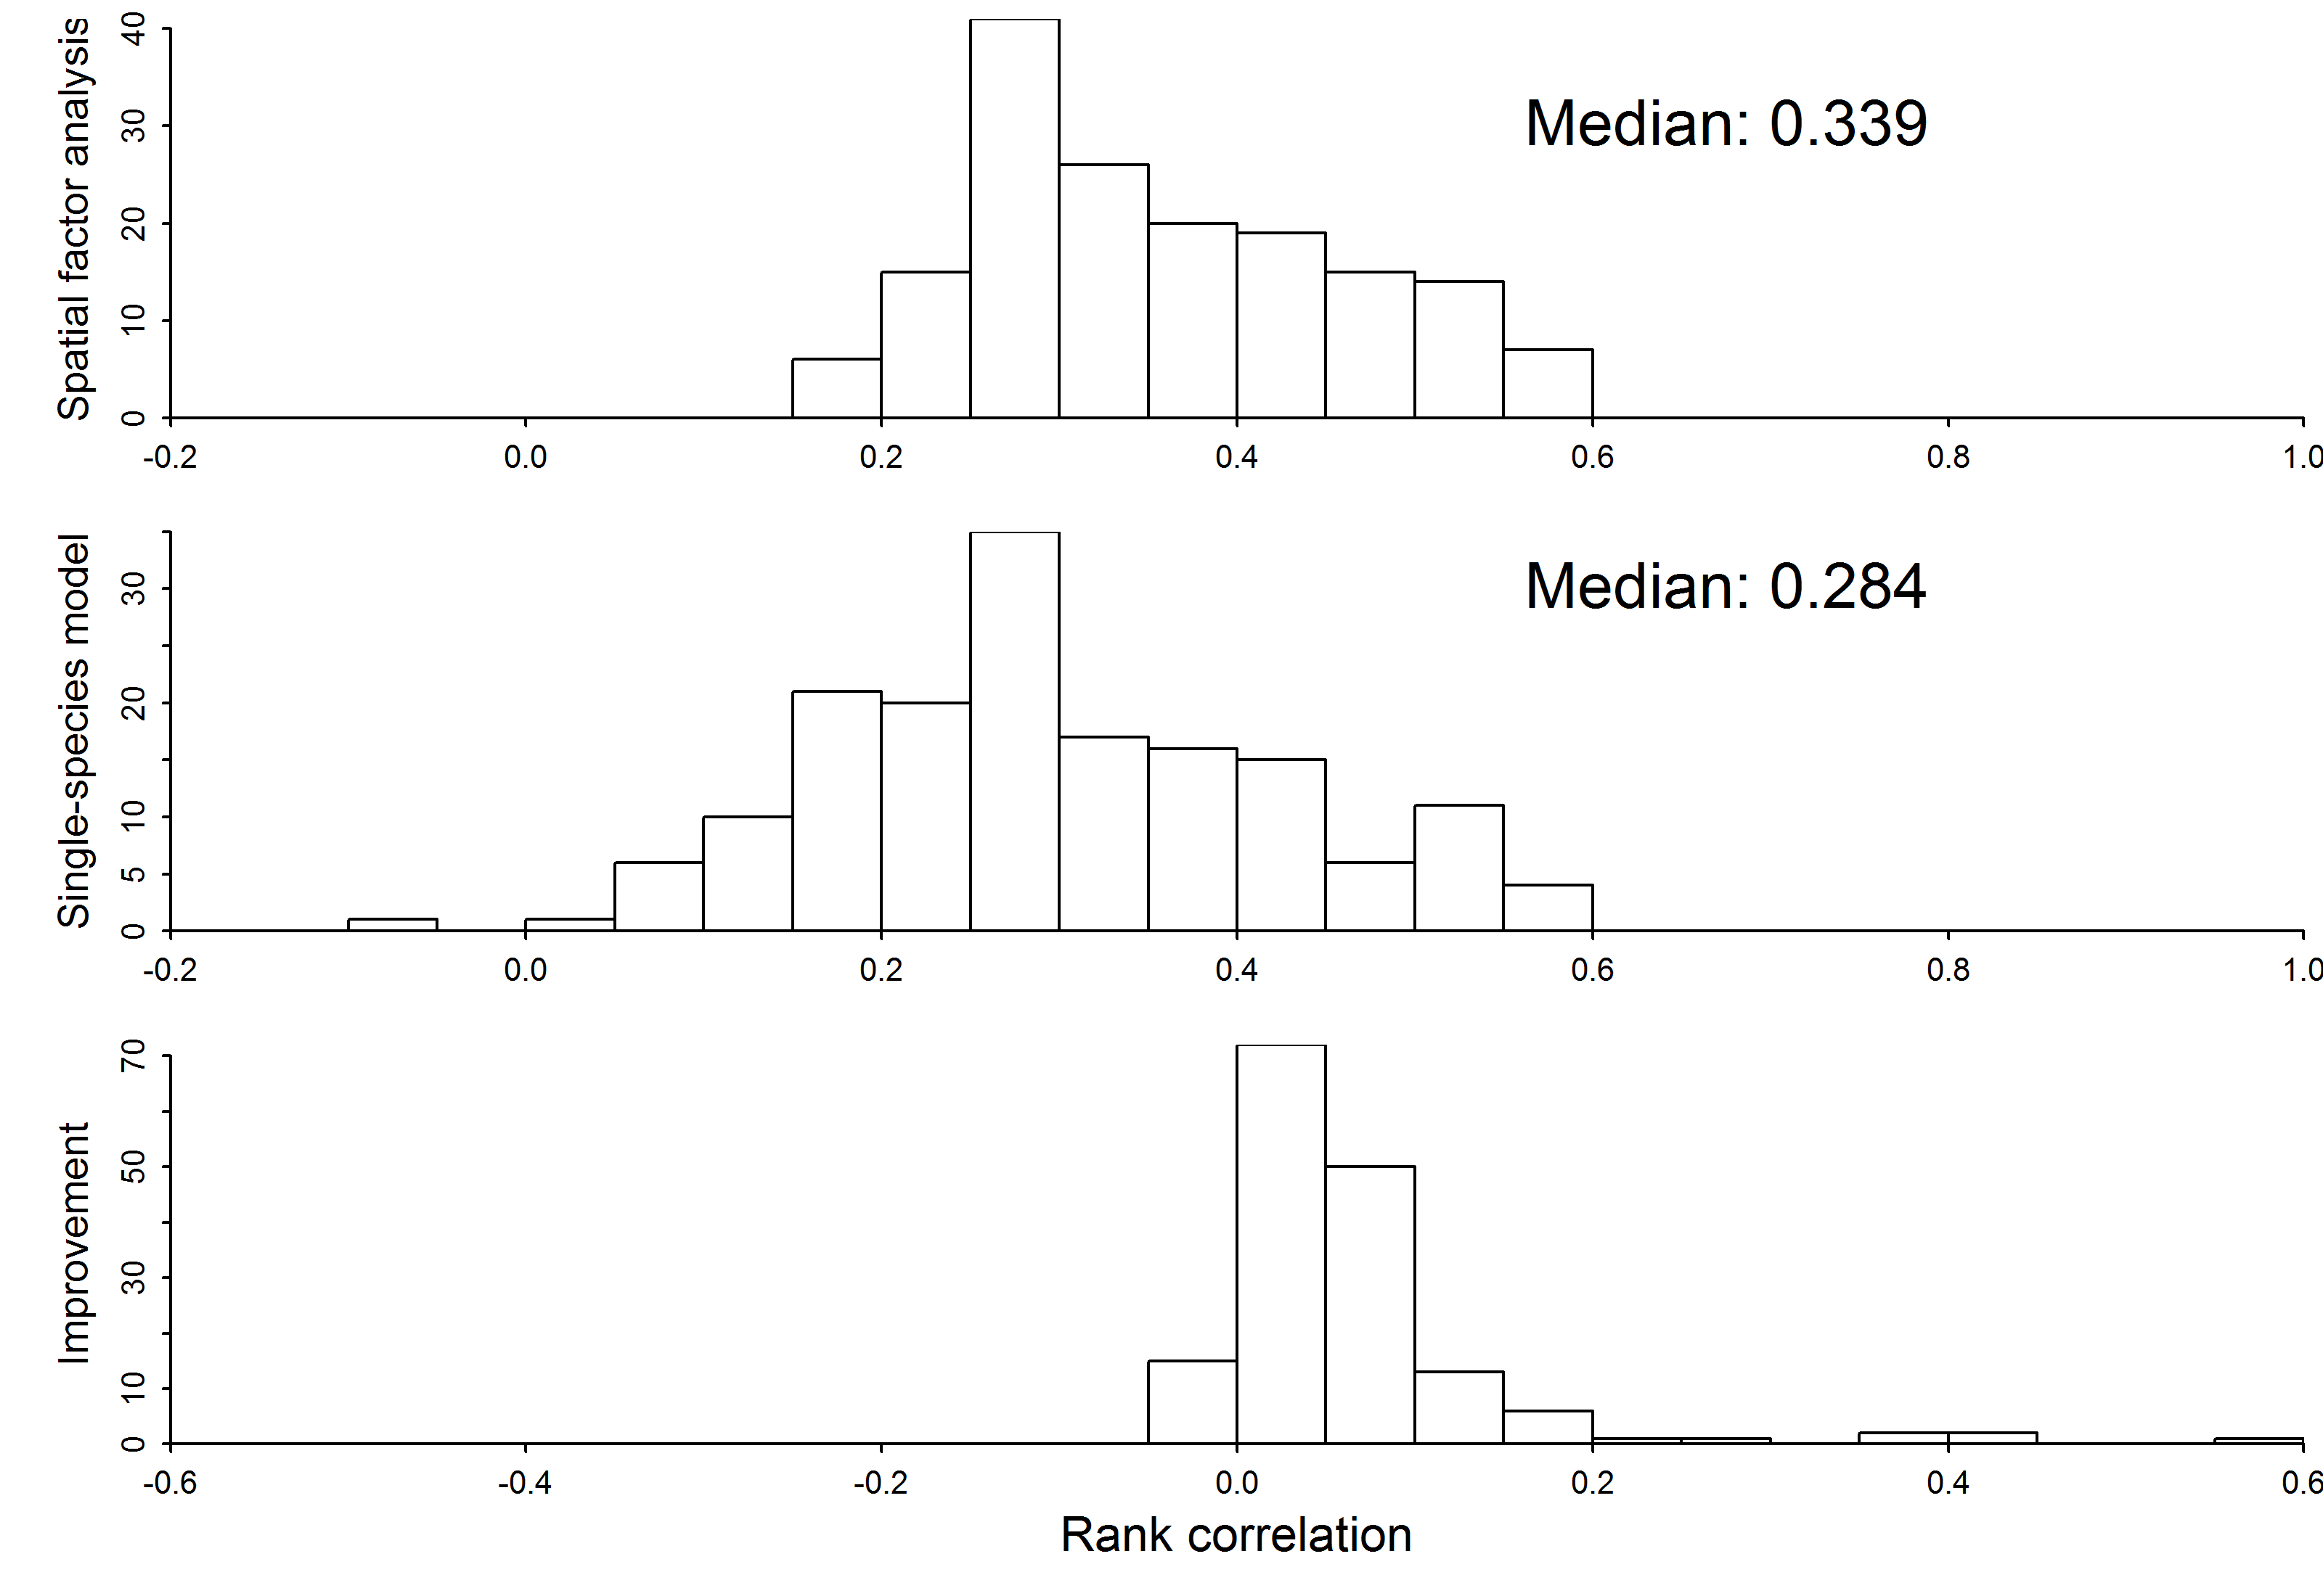
Community distribution models
Improves prediction
Spatial factor analysis
Single species models
Difference between methods
Bad Predictive accuracy Good
Notes:
Label y-axis
Bottom one; show line dividing single species and multispecies

Slide 13
Community distribution models
Factor analysis
Warton, D.I., Blanchet, F.G., O’Hara, R.B., Ovaskainen, O., Taskinen, S., Walker, S.C., Hui, F.K., 2015. So Many Variables: Joint Modeling in Community Ecology. Trends Ecol. Evol.
Spatial factor analysis
Thorson, J.T., Scheuerell, M.D., Shelton, A.O., See, K.E., Skaug, H.J., Kristensen, K., 2015. Spatial factor analysis: a new tool for estimating joint species distributions and correlations in species range. Methods Ecol. Evol. 6, 627–637. doi:10.1111/2041-210X.12359
Dynamic factor analysis
Zuur, A.F., Tuck, I.D., Bailey, N., 2003. Dynamic factor analysis to estimate common trends in fisheries time series. Can. J. Fish. Aquat. Sci. 60, 542–552. doi:10.1139/f03-030

